Slide 1

German Traffic Sign Classification Using TensorFlow
Arpan Pradhan
5-18-2024
GitHub link: https://github.com/ArpanUchicago/German-Traffic-Sign-Classification

Slide 2





Problem Statement :
The German Traffic Sign Recognition Benchmark (GTSRB) dataset presents a challenge in accurately classifying traffic sign images, which is crucial for developing robust autonomous driving systems. With over 50,000 labeled images across 43 classes, the dataset poses a classification task with significant complexity due to variations in lighting conditions, occlusions, and geometric transformations.
To address this challenge, the task involves implementing the LeNet convolutional neural network architecture to classify traffic sign images with high accuracy and efficiency.

Slide 3

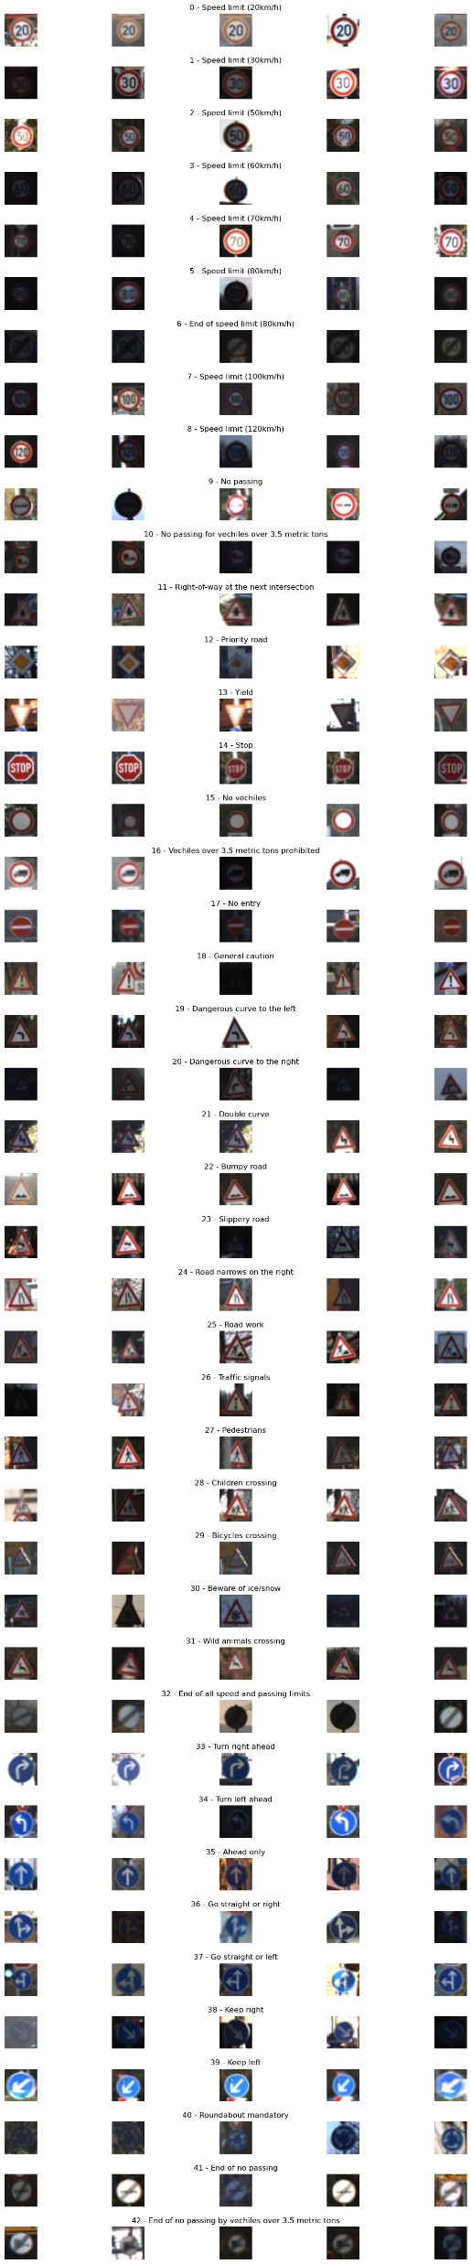

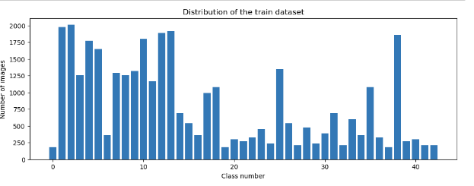
Limited Data per Class: Dataset contains 43 classes, ununiformly distributed within each class.
Class Imbalance: Some classes had significantly fewer samples, causing imbalanced class distributions.
Model Overfitting: Risk of overfitting due to smaller dataset size, especially for classes with fewer instances.
Feature Representations: Despite limited data, the model is expected to learn informative features.
Train Images
Train images
Non-Uniform distribution of train dataset

Slide 4

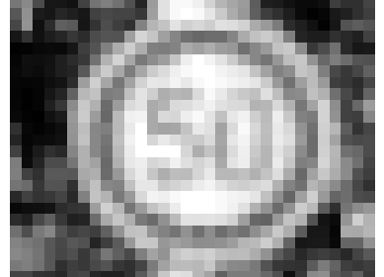

Grayscale Conversion: Converted RGB images to Grayscale
Histogram Equalization: Enhanced image contrast and standardize lighting.
Example code: img = cv2.equalizeHist(img)
Enhanced image contrast and standardize lighting.
Example code: img = cv2.equalizeHist(img)
One-Hot Encoding: Converted categorical labels to binary vectors.
Normalization: Scale pixel values to [0, 1] range for model training.
Example code: img = img / 255
Data Shape : Reshaped data to the required format for model training.

Slide 5
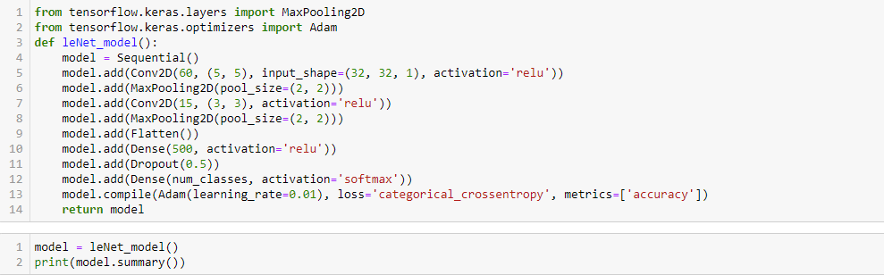
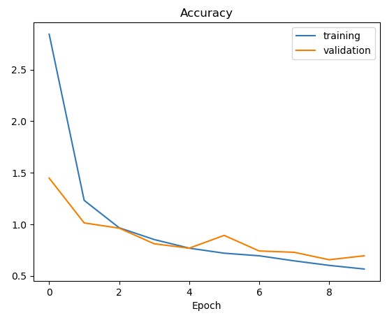
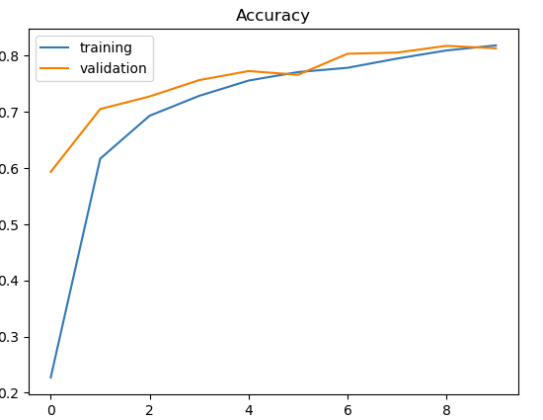
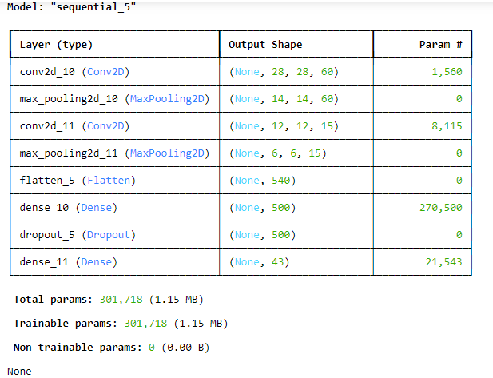
Baseline Model
Training vs Validation Loss
Training vs Validation Accuracy
Notes:
Correction : Accuracy and Loss Curve

Slide 6
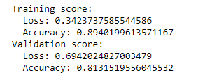

Base Model Evaluation
Overfitting : Large gap between training and validation losses
Test Accuracy of 80%
Validation accuracy close to test accuracy
Underfitting and high train and validation loss
Accuracy Matrices

Slide 7

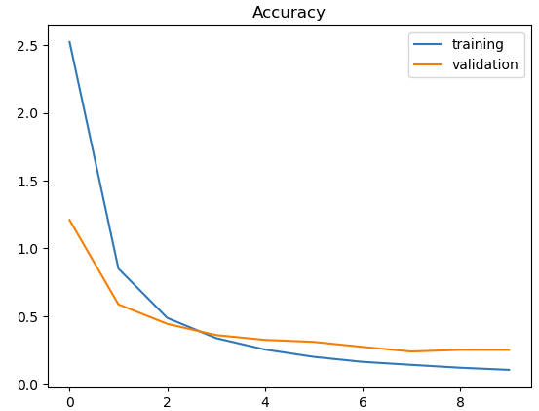
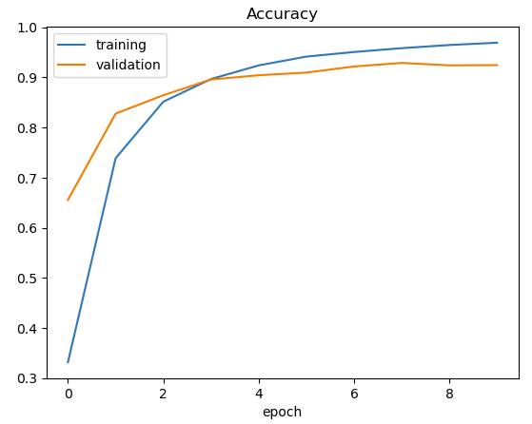

Impact of Learning Rate on Model Accuracy
Original Learning rate: 0.01
Model performance: Test accuracy of 80%, Test loss of 0.762
Higher learning rate led to overshooting or instability during training
Results: Lower learning rate facilitated smoother convergence and better generalization.
Adjusting learning rate from 0.01 to 0.001 resulted in a notable improvement in model accuracy.
Notes:
Correction : Accuracy and Loss vs Epoch

Slide 8
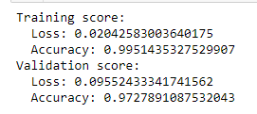

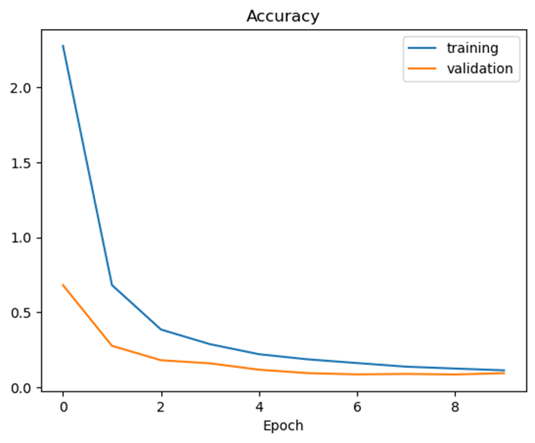
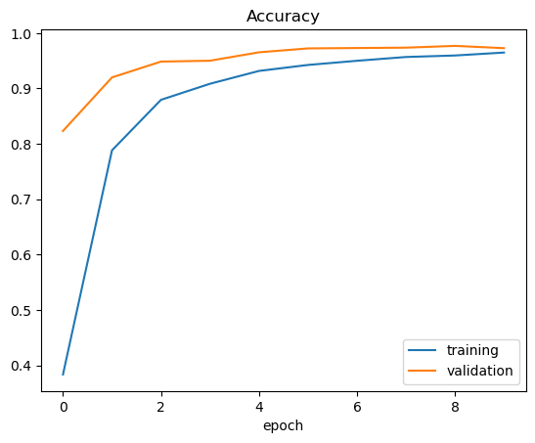
Model Enhancement with Convolutional Layers and Dropout
Added 2 Convolutional Layers to allow feature extraction
2 Dropout Layers introduced after each Convolutional Layer to prevent overfitting.
Progression of loss and accuracy metrics throughout training epochs.
Notes:
Correction : Accuracy and Loss Curve

Slide 9
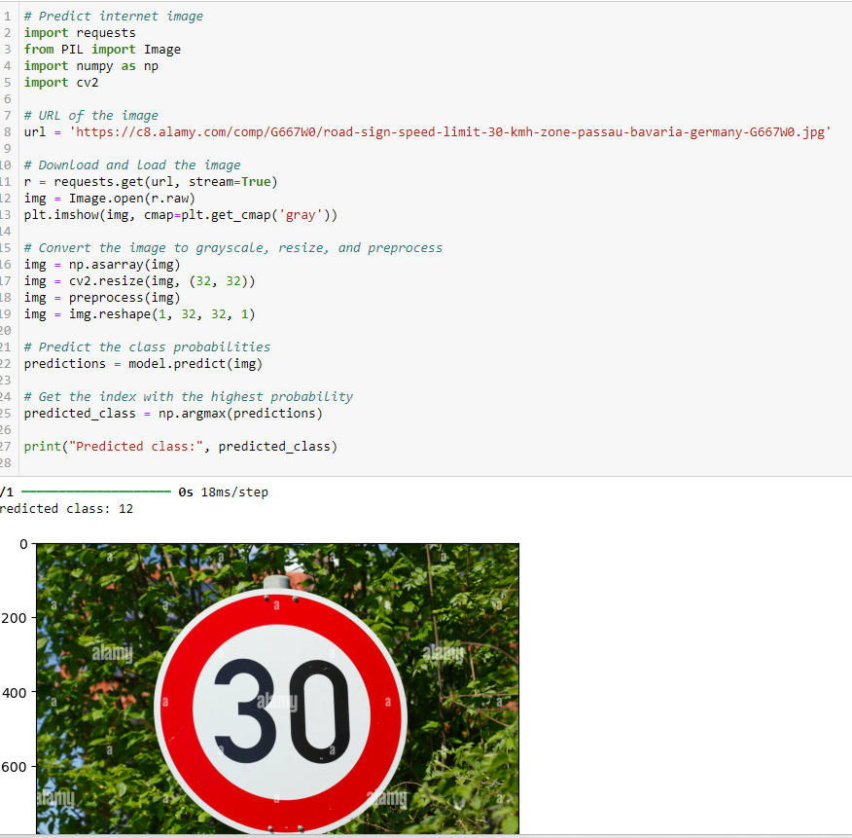

Model Prediction Analysis
Model inaccurately predicted "Priority Road" for the actual class "Speed Limit 30kph".
Misclassification highlights a potential limitation in the model's ability to distinguish between similar traffic sign classes
Proposed Solution : Augment training data with additional examples of similar sign classes to improve model differentiation.

Slide 10
Data Augmentation
Augmentation boosts dataset size and exposes models to varied perspectives, aiding robust feature extraction.
Keras ‘ImageDataGenerator’ to define and apply transformations like rotation, zoom, shear
Incorporate augmented data into model training using ‘model.fit_generator’
Model achieved over 99% training accuracy, indicating improved learning capability.
Test and Validation accuracy also increases, showcasing enhanced generalization.
Augmented Images

Slide 11
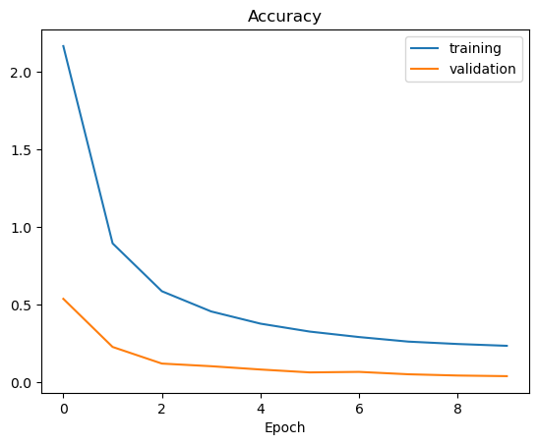
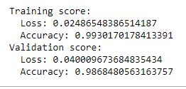
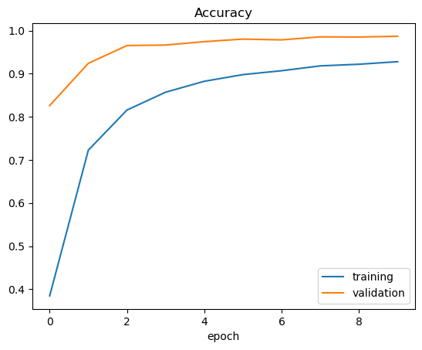

Model Performance After Data Augmentation
Training and validation gap is still high
Model is underfitting
Notes:
Correction : Accuracy and Loss ( Training and validation loss ) Per Epoch

Slide 12
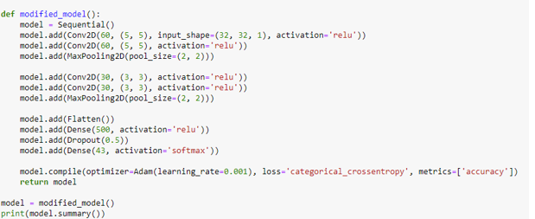
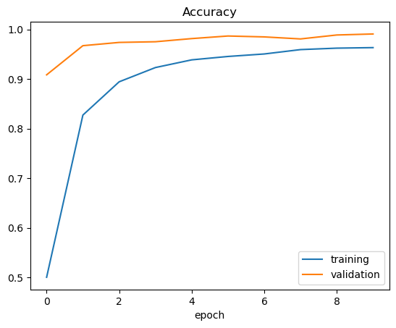
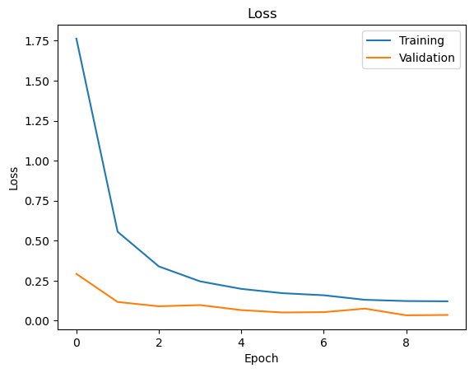
PROPOSED SOLUTION:
Dropout layers may overly regularize the model, leading to underfitting.
Remove one dropout layer
Training and validation accuracy and loss curves before after dropout layer removal.
Improved convergence and model performance matrices

Slide 13
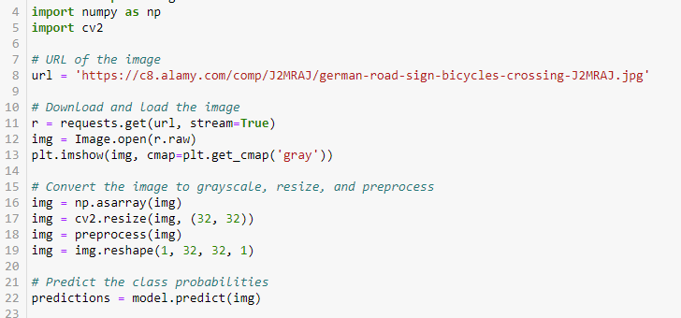
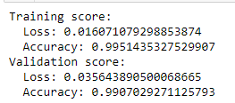
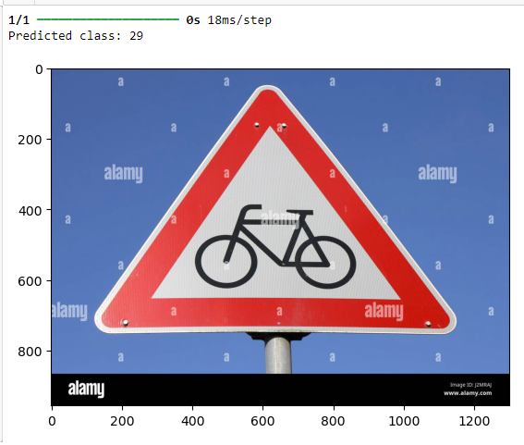

Web Image Prediction Results.
Applied the trained model to predict the class labels of web images.
Evaluated model performance on five web images.

Slide 14
Results (Accuracy) and Learnings from the methodology:
Achieved 97.52% test accuracy through the adoption of a deep learning framework, despite the intricate nature of the dataset.
Advanced data augmentation techniques, such as rotation, zooming, and shearing, were instrumental in enriching the dataset, thereby enhancing the model's generalization capabilities.
Strategies to mitigate overfitting and underfitting were rigorously implemented, including the incorporation of convolutional layers and fine-tuning of learning rates to optimize gradient descent.
Diligent removal of dropout layers further refined the model's architecture, contributing to improved performance metrics.
These combined efforts resulted in a substantial boost in the model's robustness and adaptability, affirming the efficacy of the deep learning approach in tackling complex datasets

Slide 15
Future work
Enhanced Data Collection: Employ active learning strategies to iteratively collect new samples which falls within underrepresented classes. Utilize techniques like crowd-sourcing or domain adaptation to gather diverse data across different geographic regions and environmental conditions, ensuring comprehensive coverage of real-world scenarios.
Fine-Tuning Architectures: Conduct systematic hyperparameter tuning experiments using random search or Bayesian optimization to optimize network architectures.
Transfer Learning: Investigate domain adaptation methods such as domain adversarial training or gradient reversal layers to adapt pre-trained models from related domains (e.g., general object recognition) to the specific task of traffic sign classification.
Semantic Segmentation: Implement state-of-the-art semantic segmentation architectures like U-Net or DeepLabv3+ tailored to traffic sign segmentation tasks.
Real-time Deployment: Optimize model architectures for deployment on resource-constrained platforms by employing techniques like model quantization, weight pruning, or knowledge distillation.
Deployment in Autonomous Vehicles: Develop customized inference pipelines tailored to the latency and throughput requirements of autonomous driving systems, incorporating techniques like model pipelining or asynchronous processing to maximize utilization of computational resources.

Slide 16
REFERENCES:
Slim, J. (n.d.). German Traffic Signs. Bitbucket. Retrieved from https://bitbucket.org/jadslim/german-traffic-signs

